Slide 1
Yuppies, Cougars, and Tweeps - OH MY!
Uses of Large Geo Datasets

Slide 2
With great geo data comes….
… great opportunity
… great responsibility
… great heat maps of cougar & yuppie density

Slide 3
Approaches
Extrapolation
Mashups
Data mining

Slide 4
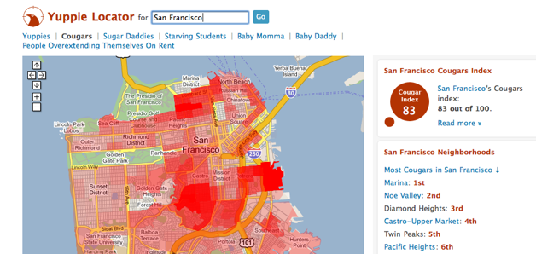
Cougar Density San Francisco

Slide 5
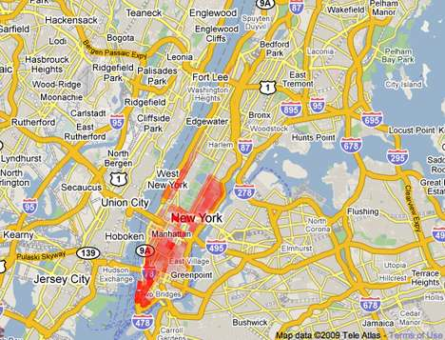
Sugar Daddy Density in NYC

Slide 6
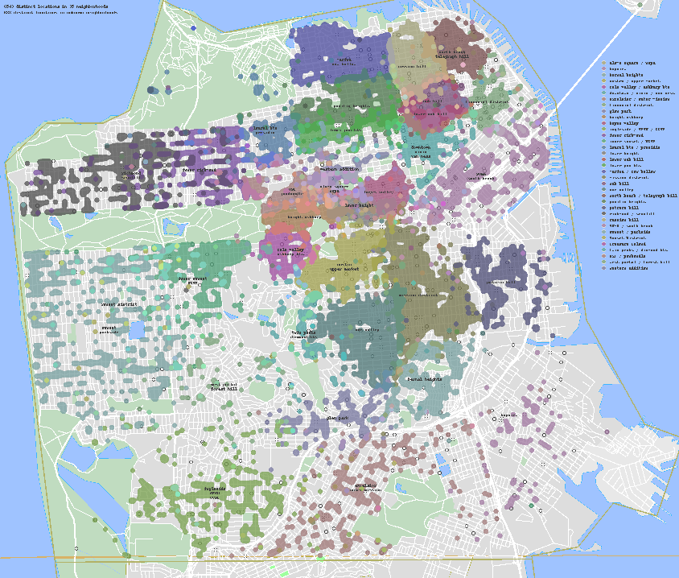
Implicit applications of geo data
Neighborhood project (Matt Chisholm, Ross Cohen)

Slide 7
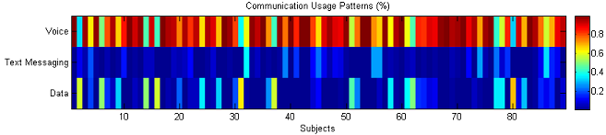
Implicit applications of mobile data:
Social Evolution Project, Human Dynamics Group, MIT Media Lab: Anmol Madan and Dr. Alex Pentland http://social.media.mit.edu and http://hd.media.mit.edu
Used mobile phones to capture behaviors for 80 people for 1 year-- about 320,000 hours of data
Obama-McCain campaign – people cluster with others of similar opinions at e.g. debates and election day, but these effects only last for 2-3 days. Mobile phone based features can be used to predict how opinions evolve and people vote in the elections (R sqr = 0.8, p < 0.001)
Can predict when people have common colds, flu or are stressed/depressed. This is because people show changes in behavior (communication style, movement patterns).

Slide 8
Summary
Lots of interesting new data sets
Lots of cool uses
Make sure user privacy preserved

